Slide 1
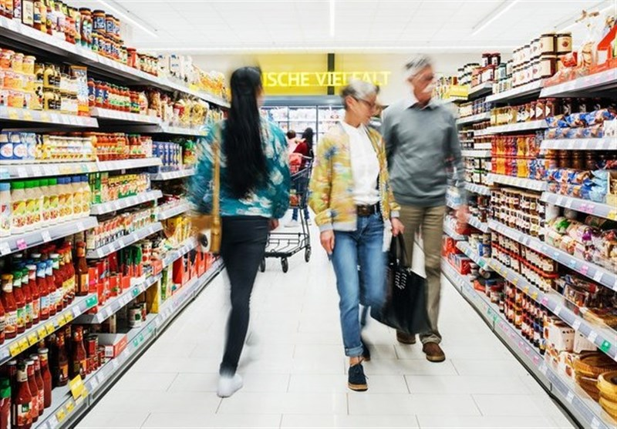
Retail sales and Analytics
Presented By – Rahul Kumar

Slide 2
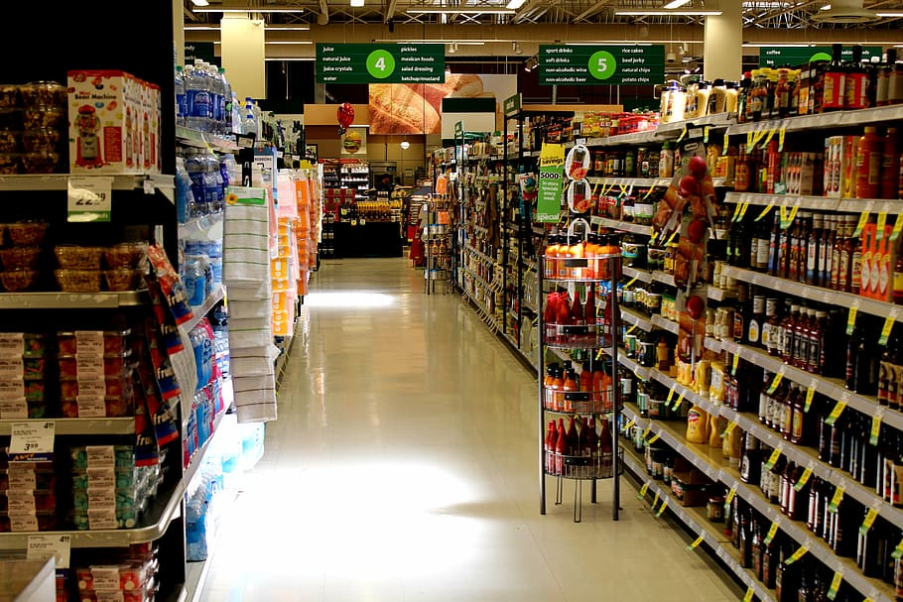
WHAT’S IN THIS
Hello, In this Project I tried to Analyze Retail sales Pattern by doing Customer Segmentation , Inventory Analysis Sales Analysis, Store Analysis . I used Python for Data Cleaning and Done EDA Part, SQL For Querying and Aggregating and then Power-BI for creating visuals and charts. I also made Beautiful and Interactive Dashboards.

Slide 3
Introduction
Retail businesses generate vast amounts of data, and analyzing this data is essential for making informed business decisions. This project focuses on exploring and analyzing retail sales data to gain actionable insights into customer behavior, inventory management, sales trends, and store performance.
This project focuses on exploring and analyzing retail sales data to derive meaningful insights into:
✅ Customer Segmentation – Understanding buying patterns and customer behavior.
✅ Inventory Management – Tracking stock levels and product demand.
✅ Sales Analysis – Identifying revenue trends and top-performing products.
✅ Store Performance – Comparing sales across different store locations.
By leveraging SQL, Python, and Power BI, this analysis provides a data-driven approach to improving retail operations and business performance.

Slide 4
Approach:
Data Extraction & Cleaning (Using SQL & Python for preprocessing)
Exploratory Data Analysis (Identifying trends, patterns, and key metrics)
SQL-Based Analysis (Performing customer segmentation, sales trends, and inventory tracking)
Power BI Visualization (Creating interactive dashboards to present insights)
Conclusion & Recommendations (Summarizing findings and business improvements)

Slide 5
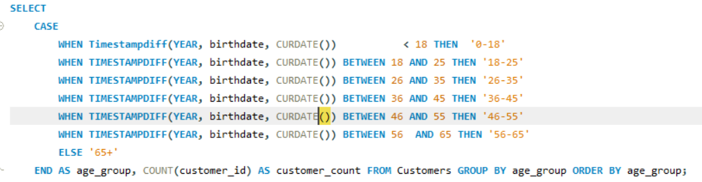
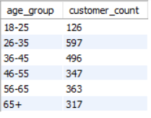
Customer - Segmentation
Classify customers into different age groups (18-25, 26-35, etc.) and determine the number of customers in each category to understand demographic distribution.
It shows the total number of customers in different type of age group

Slide 6
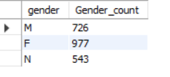
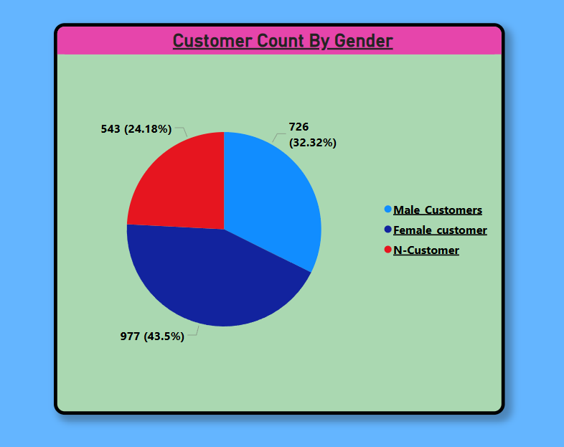
Analyze the number of male and female customers to identify any potential gender imbalance in the customer base.
IT SHOWS CUSTOMER DISTRIBUTION AMONG GENDERS BY MALE,FEMALE AND NON-BINARY

Slide 7
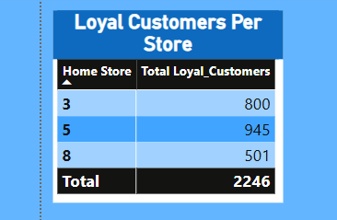
Identify stores with the highest number of loyal customers to understand customer retention patterns across locations.
IT SHOWS THAT THE HIGHEST NUMBER OF LOYAL CUSTOMERS IS IN STORE 5.

Slide 8
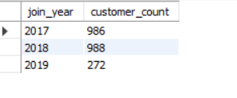
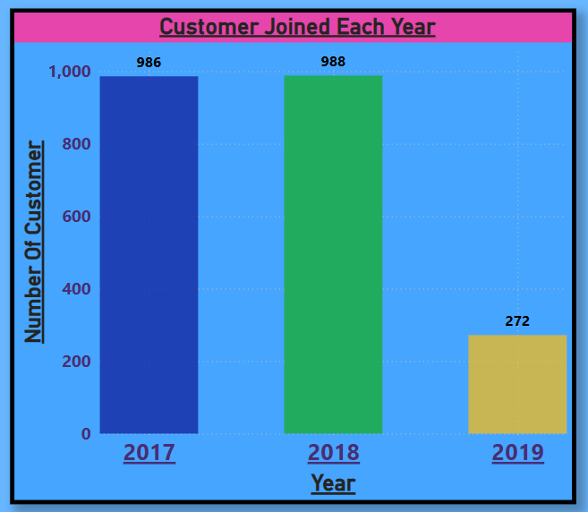
Count how many customers joined each year to understand the trend of customer growth over time.
IT TELLS ABOUT THE GROWTH IN NUMBER OF CUSTOMER THAT IS IN 2018 BY 988 CUSTOMERS.

Slide 9
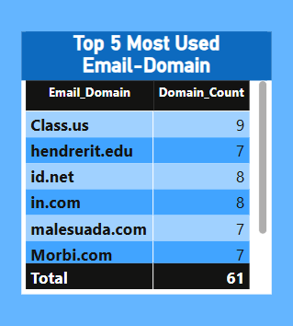
Identify the five most common email domains used by customers to understand popular email preferences.
IT SHOWS THE TOP 5 MOST COMMON EMAIL DOMAIN IN WHICH THE MOST COMMON IS CLASS.US

Slide 10
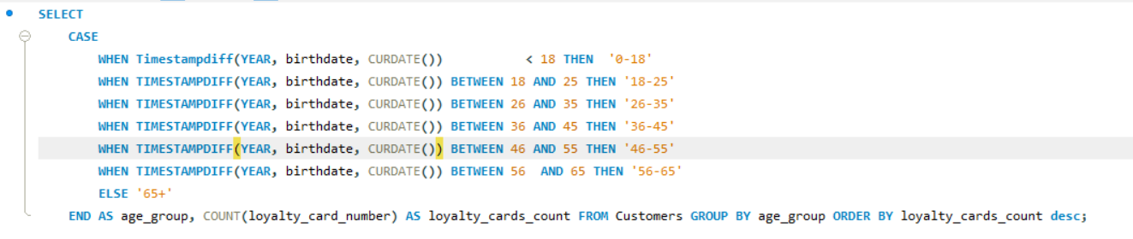
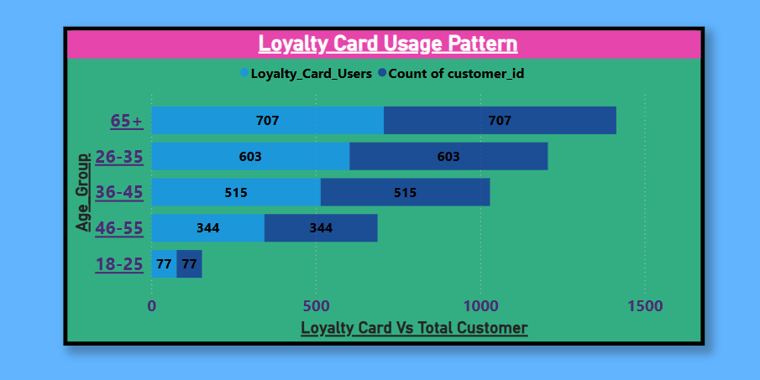
Analyze how different age groups use loyalty cards to determine whether younger or older customers engage more
IT SHOWS THE LOYALTY CARD USAGE PATTERN BY DIFFERENT AGE GROUP WHICH IS MOSTLY USED BY 65 +

Slide 11
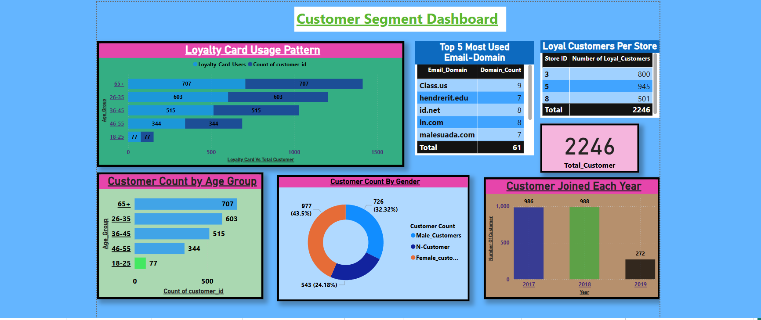

Slide 12
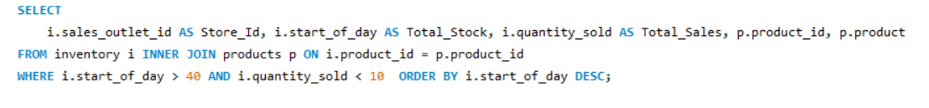
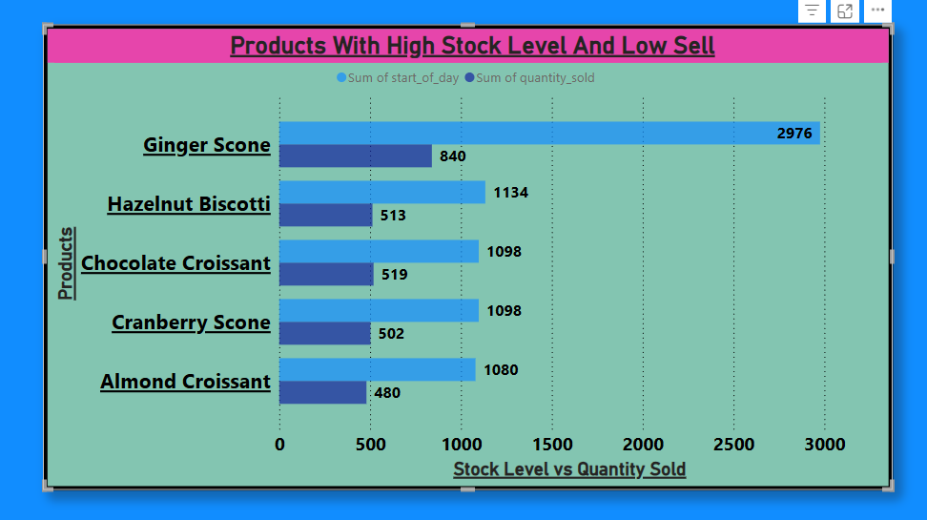
Inventory Analysis
Identify products that have high stock levels but low sales over time. These products may be overstocked and should be considered for discounts or promotions ?
IN THIS THE GINGER SCONE IS HIGHLY STOCKED AND HAVING LOW SALE IT NEEDS TO BE PROMOTED OR DISCOUNTED

Slide 13

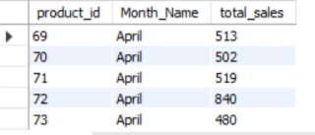
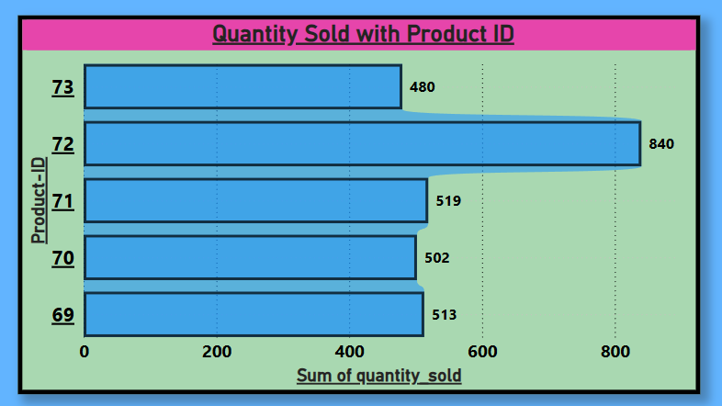
Identify products that have high sales fluctuations based on different time periods (e.g., months or quarters)?

Slide 14
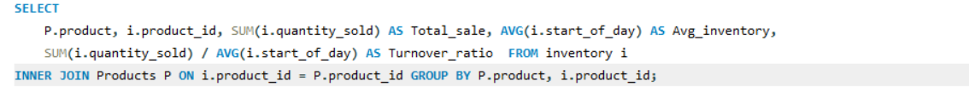
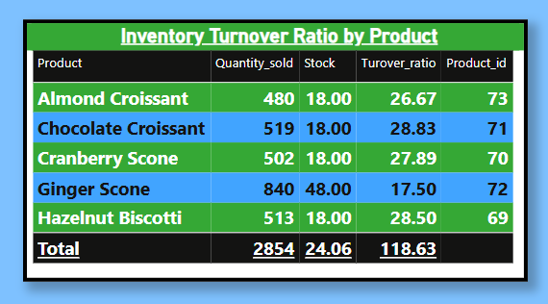
Calculate the Inventory Turnover Ratio for each product. This ratio helps determine how efficiently inventory is being sold and replaced ?

Slide 15
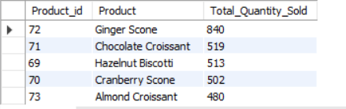
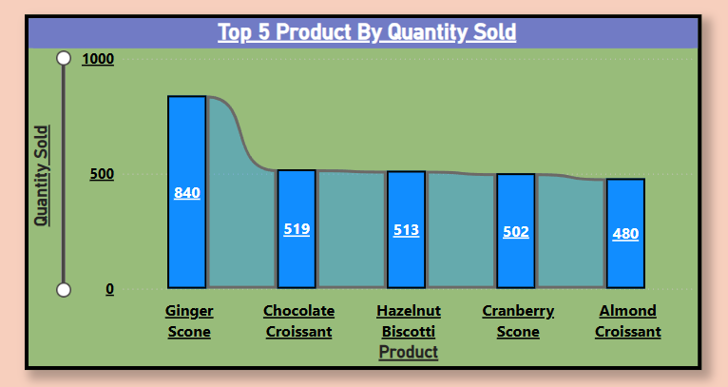
Sales Analysis
Identify the top 5 best-selling products based on total quantity sold ?

Slide 16
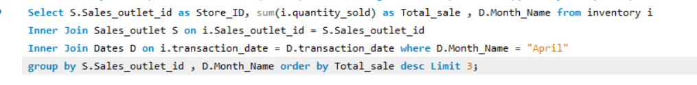
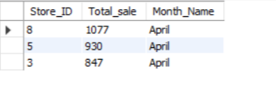
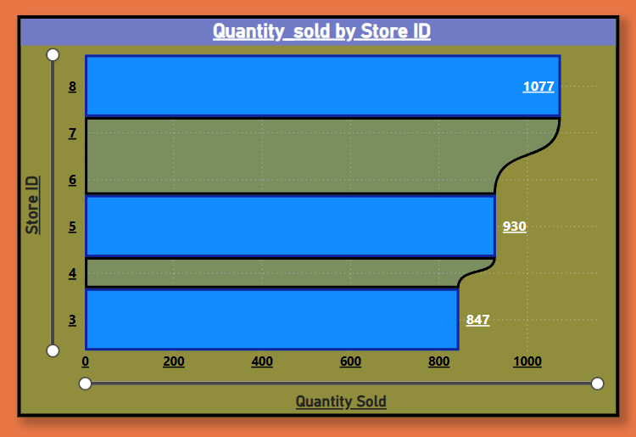
Identify the top 3 sales outlets (stores) with the highest total purchases (quantity sold) in April.

Slide 17
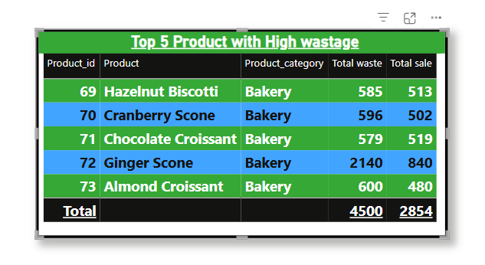
Identify Top 5 products with the highest wastage to help improve inventory management and minimize losses ?

Slide 18
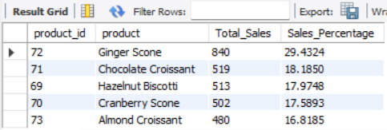
Determine the percentage contribution of each product to the total sales in April ?

Slide 19
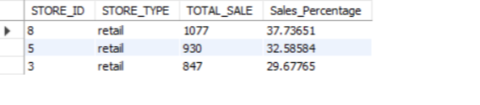
Store Analysis
Identify the top-performing Store based on total quantity sold. Determine which stores contribute the most to overall sales ?

Slide 20
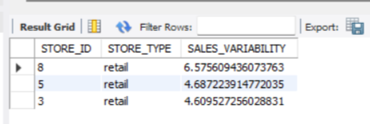
Identify stores with the highest sales variability to determine which stores have the most inconsistent sales patterns

Slide 21
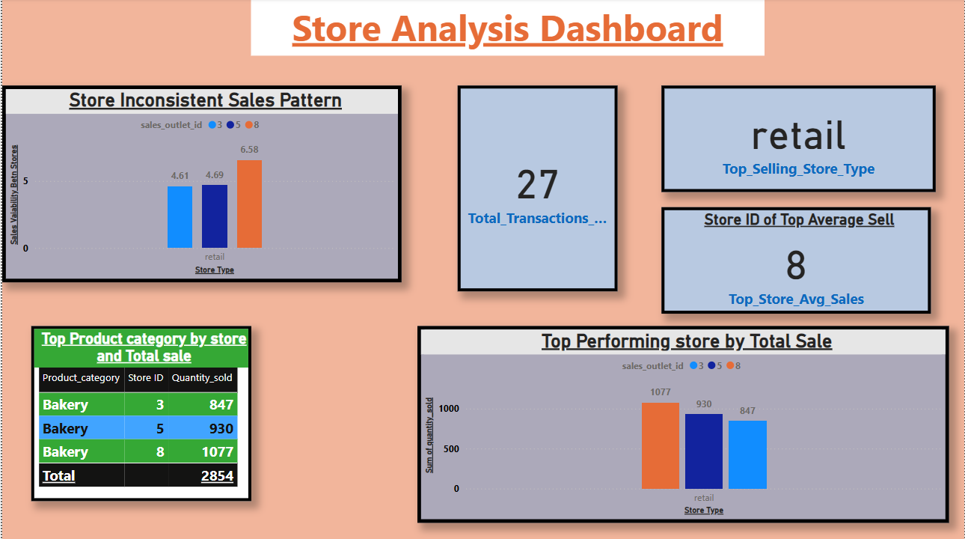

Slide 22
Conclusion
In this project, we successfully analyzed retail sales data to gain valuable insights into customer behavior, inventory management, sales trends, and store performance. By leveraging SQL, Python, and Power BI, we identified actionable findings that can drive business growth and operational efficiency.
Key Insights:
Customer Segmentation: Store 5 has the highest number of loyal customers, and the most active age group using loyalty cards is 65+.
Inventory Management: Products like Ginger Scone show high stock levels but low sales, suggesting a need for promotional strategies.
Sales Trends: The top 5 best-selling products contribute significantly to total sales, and April experienced high store activity.
Store Performance: Store 5 outperformed other locations, while certain stores showed inconsistent sales patterns.

Slide 23
Recommendations:
Implement targeted promotions and discounts on underperforming products.
Develop customer retention programs in stores with fewer loyal customers.
Monitor stores with high sales variability for better forecasting and inventory management.
Focus on maintaining inventory turnover to minimize product wastage.
These insights provide a data-driven foundation for strategic decision-making in retail operations, ultimately contributing to improved sales performance and customer satisfaction.

Slide 24

About me :
Email-id : rahulbabu7177@gmail.com
Phone No : 9304283832

